Slide 1
Exercise Prescription
Certificate Course
Session 2:
Principles and Frameworks for Exercise Prescription

Slide 2
Outline of this Session
Overview of Exercise Prescription
Principles of Prescribing Aerobic Exercise
  The FITT Principle including assessments on Activity Intensity
Global Recommendations on Physical Activity for Health
Recommendations for Prescribing Exercise to Healthy Adults
Recommendations for Prescribing Exercise to Older Adults
Practical Examples of Aerobic Exercises

Slide 3
Overview of
Exercise Prescription

Slide 4
What We Know from Research…
Regular PA reduces the risk of many adverse health outcomes
Health benefits occur for all age and racial group, as well as people with disabilities
Benefits of PA far outweigh the possibility of adverse outcomes
Some physical activity is better than none
Both aerobic and muscle-strengthening (resistance) PA are beneficial
Most health benefits occur with at least 150 mins a week of moderate-intensity PA. Additional benefits occur as the amount of PA increases

Slide 5
What is Exercise Prescription?
The process of designing a regimen of PA for a client/patient in a systematic and individualized manner for a specified purpose
Based on specific and unique needs and interests of the client/patient, as well as results of their clinical assessments
The goal should be successful integration of exercise principles and behavioral techniques that motivates the participant to be compliant, thus achieving their purpose

Slide 6
Principles of
Prescribing Aerobic Exercise

Slide 7

Definition of Aerobic Exercise
Any activity that
  uses large muscle groups,
  can be maintained continuously, and
  is rhythmical in nature

Slide 8
FIVE Essential Components of
Prescribing Aerobic Exercise
FITT
Frequency
Intensity
Time (Duration)
Type
Progression
Dosage of Exercise
Notes:
The dosage of aerobic exercise is a function of the frequency (F), intensity (I) and duration (time, T) of the exercise performed.

Slide 9
The “Frequency” of Prescribed Aerobic Exercise
FITT
Usually expressed as the number of days per week dedicated to an exercise session
E.g. 5 times per week

Slide 10
The “Intensity” of Prescribed Aerobic Exercise
FITT
Refers to how hard a person works to do the activity
  Moderate-intensity: can talk, but not sing
  Vigorous-intensity: cannot say more than a few words without pausing for a breath
Other Methods for Assessing Aerobic Intensity:
  Metabolic equivalents (METs)
  %HR_{max} OR %HRR
  %VO_{2max} OR %VO₂R
  Ratings of perceived exertion (RPE)

Slide 11
The “Intensity” of Prescribed Aerobic Exercise - METs
FITT
METs express aerobic intensity as mL/kg of body weight/min of oxygen being consumed
1 MET is the rate of energy expenditure while sitting at rest (by convention: oxygen uptake of 3.5 mL/kg/min)
Intensity Classification by METs:
  Light 1.1-2.9 METs
  Moderate 3-5.9 METs
  Vigorous ≥ 6 METs

Slide 12
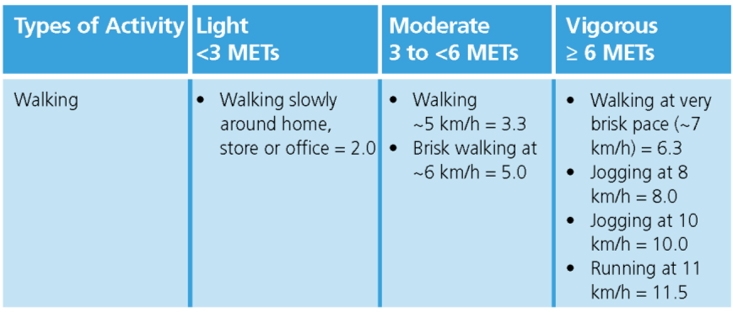
The “Intensity” of Prescribed Aerobic Exercise – by METs
FITT

Slide 13

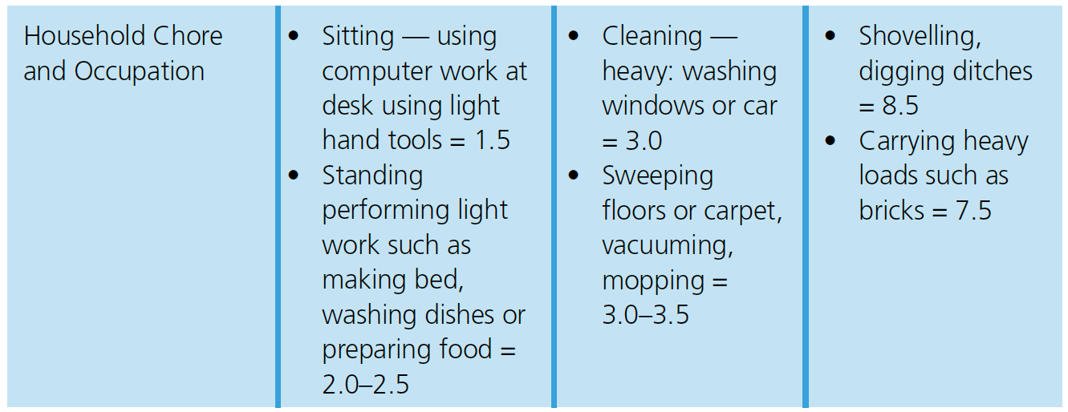
The “Intensity” of Prescribed Aerobic Exercise – by METs
FITT

Slide 14
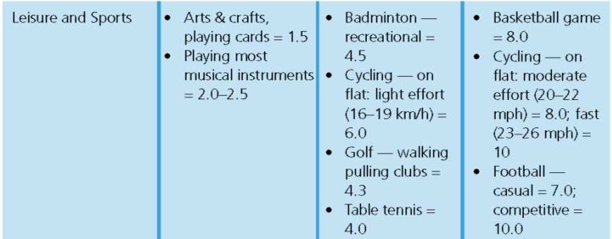
The “Intensity” of Prescribed Aerobic Exercise – by METs
FITT

Slide 15
The “Intensity” of Prescribed Aerobic Exercise – by %HRR or %HR_{max}
FITT
Aerobic intensity can be expressed as a % of one’s:
  Maximum heart rate (%HR_{max}) OR
  Heart rate reserve (%HRR)
HR_{max} : estimated by person’s age by
  “220 – age” (applied to adults ≥ 19 year-old only), or
  some other prediction equation
HRR:
  HRR = HR_{max} – Resting HR

Slide 16
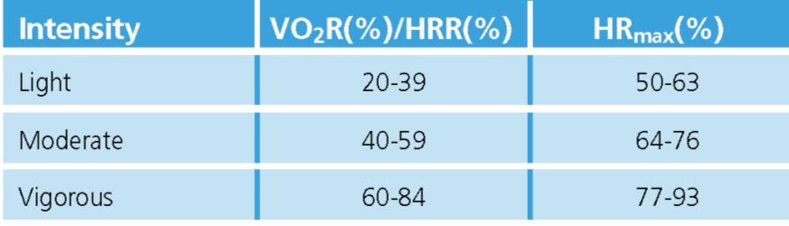


The “Intensity” of Prescribed Aerobic Exercise – by %HRR or %HR_{max}
FITT

Slide 17
The “Intensity” of Prescribed Aerobic Exercise – by %VO2_{max}/%VO₂R
FITT
Aerobic intensity can be expressed as a percentage of a person’s:
  Maximal oxygen uptake/aerobic capacity (%VO_{2max})
  Oxygen uptake reserve (%VO₂R)
The person’s VO_{2max} & VO₂R could be estimated by an exercise test

Slide 18
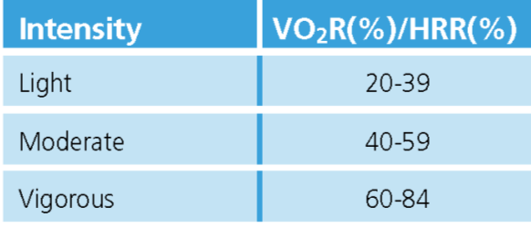

The “Intensity” of Prescribed Aerobic Exercise – by %VO₂R
FITT

Slide 19
The “Intensity” of Prescribed Aerobic Exercise – by RPE
FITT
An index of how hard the person feels he or she is exercising (e.g. a 0 to 10 scale)
Borg RPE Scale
  A scale ranges from 6 to 20, where 6 means "no exertion at all" and 20 means "maximal exertion“
preferred method to assess intensity among those individuals who take medications that affect heart rate or pulse

Slide 20
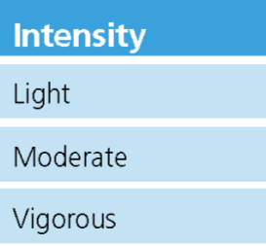
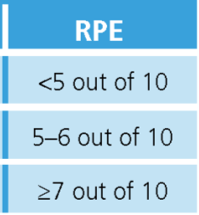
The “Intensity” of Prescribed Aerobic Exercise – by RPE (a 0 to 10 scale)
FITT

Slide 21
The “Time” of Prescribed Aerobic Exercise
FITT
Refers the length of time in which an activity or exercise is performed
Time (Duration) is generally expressed in minutes e.g. 30 min/day or 150 min/week

Slide 22
The “Type” of Prescribed Aerobic Exercise
FITT
The mode of exercise performed
Some require little skill to perform e.g. brisk walking, leisure cycling, swimming, aqua-aerobics and slow dancing
Some generally perform at a higher activity intensity e.g. jogging, running, aerobics, stepping exercise, fast dancing

Slide 23
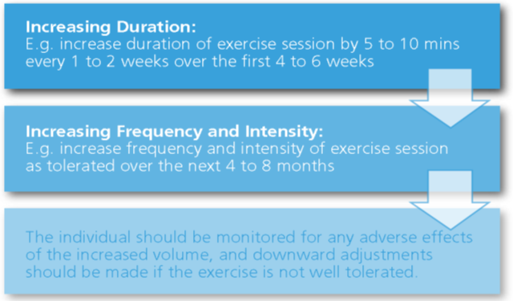
The “Progression” of Prescribed Aerobic Exercise
Recommended Sequence of Progression of Aerobic Exercises

Slide 24
FIVE Essential Components of
Prescribing Aerobic Exercise
FITT
Frequency
Intensity
Time (Duration)
Type
Progression
Dosage of Exercise
Notes:
The dosage of aerobic exercise is a function of the frequency (F), intensity (I) and duration (time, T) of the exercise performed.

Slide 25
Aerobic Exercise Volume Recommendation
Target volume: > 500-1000 MET-min / wk
Approximately equal to
  1000 kcal / wk of moderate intensity PA
  150 min / wk of moderate intensity PA
  5,400-7,900 steps / d
kcal / min = [(METs x 3.5 mL/kg/min x body weight, kg) / 1000)] x 5

Slide 26
Global Recommendations on Physical Activity for Health

Slide 29
Recommendations for Prescribing Aerobic Exercise to
Healthy Adults

Slide 30
Recommendations for Prescribing Aerobic Exercise to Healthy Adults
Frequency: Perform moderate-intensity aerobic PA on at least 5 days/wk or vigorous PA on at least 3 days/wk, or a weekly combination of 3-5 days/wk of moderate- and vigorous exercise
Intensity: A combination of moderate and vigorous-intensity aerobic exercise is recommended

Slide 31
Recommendations for Prescribing Aerobic Exercise to Healthy Adults
Time:
  Perform moderate-intensity exercise for at least 30 min/d to a total of at least 150 min/wk OR vigorous intensity exercise for at least 20 min/d to a total of at least 75 min/wk. (in bouts of ≥10 min)
  To ↑health benefits, increase duration to 300 min/wk of moderate-intensity, OR 150 min/wk of vigorous-intensity exercise (or an eq. combination of both)
  PA beyond this amount may further ↑ health benefits

Slide 32
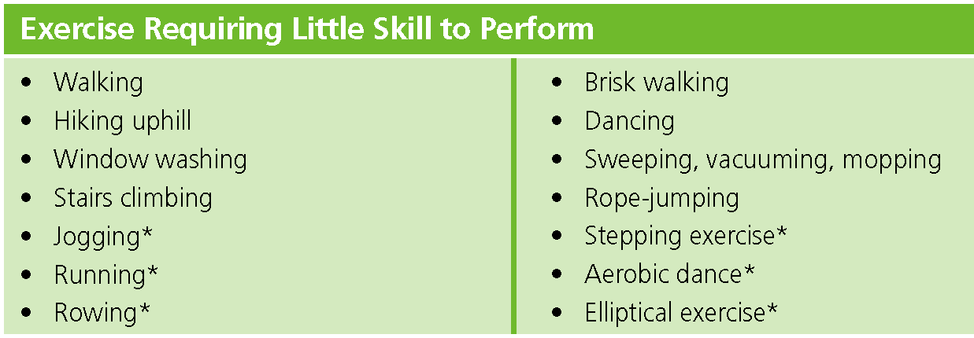
Recommendations for Prescribing Aerobic Exercise to Healthy Adults
Type:
*Typically performed in vigorous intensity

Slide 33
Special Considerations
↑physical activity gradually over time whenever more activity is necessary to meet recommendations
Inactive people should “start low and go slow”
Terminate exercise immediately and seek prompt medical care if warning signs or symptoms develop during or after exercise

Slide 34
Prescribing Aerobic Exercise to
Healthy Older Adults

Slide 35
Long Term Benefits of Exercise
Strong Evidence
Lower risk of premature death
Lower risk of CHD, stroke
Lower risk of type 2 DM & HT
Lower risk of adverse blood lipid & metabolic syndrome
Lower risk of colon & breast cancer
Weight loss & Prevention of weight gain
Prevention of falls
Reduced depression
Better cognitive function
Moderate to strong Evidence
Better functional health (for older adults)
Reduced abdominal obesity
Moderate Evidence
Reduced symptoms of depression
Lower risk of hip fracture
Lower risk of lung cancer
Lower risk of endometrial cancer
Weight maintenance after weight loss
Increased bone density
Improved sleep quality

Slide 36
Recommendations for Prescribing Exercise to Healthy Older Adults
Definition of “Older Adult”
  People with age ≥ 65 years
  People 50-64 years with clinically significant conditions or physical limitations that affect movement, physical fitness, or physical activity
Positive improvements from PA are attainable at any age
Those who cannot perform the recommended amount of PA because of chronic conditions should
  Be as physically active as their abilities / conditions allow AND
  Avoid being sedentary

Slide 37
Recommendations for Prescribing Aerobic Exercise to Healthy Older Adults
Frequency: Perform moderate-intensity aerobic PA on ≥ 5 days/wk or vigorous PA on at least 3 days/wk, or a weekly combination of 3-5 days/wk of moderate- and vigorous exercise
Intensity: A combination of moderate and vigorous-intensity aerobic exercise is recommended (Use of RPE preferable)

Slide 38
Recommendations for Prescribing Aerobic Exercise to Healthy Older Adults
Frequency: Perform moderate-intensity aerobic PA on ≥ 5 days/wk or vigorous PA on at least 3 days/wk, or a weekly combination of 3-5 days/wk of moderate- and vigorous exercise
Intensity: A combination of moderate and vigorous-intensity aerobic exercise is recommended (Use of RPE preferable)
Similar to Recommendations for Health Adults

Slide 39
Recommendations for Prescribing Aerobic Exercise to Healthy Older Adults
Time:
  Perform moderate-intensity exercise for ≥ 30 min/d to a total of ≥ 150 min/wk OR vigorous intensity exercise for ≥ 20 min/day to a total of ≥ 75 min/wk. (in bouts of ≥10 min)
  To ↑health benefits, increase duration to 300 min/wk of moderate-intensity, OR 150 min/wk of vigorous-intensity exercise (or an eq. combination of both)

Slide 40
Recommendations for Prescribing Aerobic Exercise to Healthy Older Adults
Time:
  Perform moderate-intensity exercise for ≥ 30 min/d to a total of ≥ 150 min/wk OR vigorous intensity exercise for ≥ 20 min/d to a total of ≥ 75 min/wk. (in bouts of ≥10 min)
  To ↑health benefits, increase duration to 300 min/wk of moderate-intensity, OR 150 min/wk of vigorous-intensity exercise (or an eq. combination of both)
Same as the Recommendations for Health Adults

Slide 41
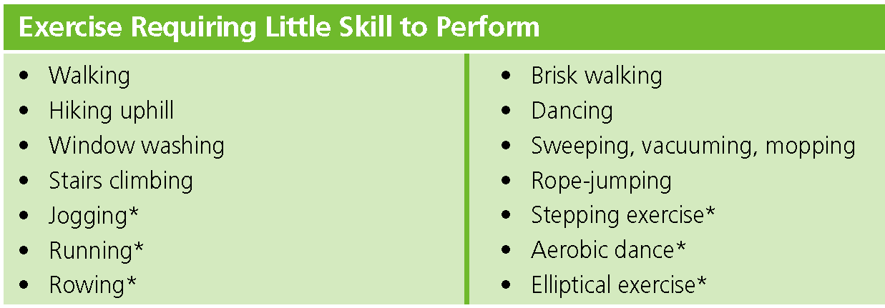
Recommendations for Prescribing Aerobic Exercise to Healthy Older Adults
Type:
*Typically performed at a vigorous intensity and recommended for those who exercise regularly or who are at least of average physical fitness

Slide 42
Recommendations for Prescribing Aerobic Exercise to Healthy Older Adults
Type:
Similar with that for Health Adults, except:
Exercise that does not impose excessive orthopaedic stress is preferable
*Typically performed at a vigorous intensity and recommended for those who exercise regularly or who are at least of average physical fitness

Slide 43
Special Precautions for Healthy Older Adults
PA Intensity and duration should be low at the beginning in particular for those are highly de-conditioned, functionally limited, or have chronic conditions that affect their ability to perform physical tasks
For resistance training involving use of weight-lifting machines, initial training sessions should be supervised and monitored by personnel who are sensitive to special needs of older adults

Slide 44
Special Precautions for Healthy Older Adults
Progression of activities should be individualized and tailored to tolerance and preference
In the early stages of exercise programme, muscle strengthening activities may need to precede aerobic exercise among very frail individuals

Slide 45

Further Reading
Hong Kong Reference Framework for Preventive Care for Older Adults in Primary Care Settings
http://www.pco.gov.hk/english/resource/professionals_preventive_older_pdf.html

Slide 46
Some Practical Examples of
Aerobic Exercise

Slide 47
End of Presentation
Please refer to Doctor’s Handbook:
Chapters 4-5 for further reading

Slide 48
Questions and Answers

